Slide 1
Backtracking
A powerful and universal algorithm

Slide 2
Backtracking
Introduction
Suppose you have to make a series of decisions, among various choices, where
  You don’t have enough information to know what to choose
  Each decision leads to a new set of choices
  Some sequence of choices (possibly more than one) may be a solution to your problem
Backtracking is a methodical way of trying out various sequences of decisions, until you find one that satisfies your objective

Slide 3
Terminology(术语）
A tree is composed of nodes
There are three kinds of nodes to be used:
The (one) root node
(start node)
Internal nodes
Live nodes
Extend nodes
Backtracking can be thought of as searching a tree for a particular “goal” leaf node
Dead nodes
leaf nodes

Slide 4
Terminology
Each non-leaf node in a tree is a parent of one or more other nodes (its children)
Each node in the tree, other than the root, has exactly one parent
parent
Usually, however, we draw our trees downward, with the root at the top
parent
children
children

Slide 5
Ideas
Backtracking is a refinement of the brute force approach, which systematically searches for a solution to a problem among all available choices. It does so by assuming that the solutions are represented by vectors (x₁,x₂,…,x_{n}) of values and by traversing, in a depth first manner, the domains of the vectors until the solutions are found.
Backtracking ensures correctness by enumerating all possibilities.

Slide 6
We build from a partial solution (x₁,x₂,…,x_{i}) and try to extend it by adding another element x_{i+1}. After extending it, we will test whether what we have so far is still possible as a partial solution.
The steps involved in the backtracking method are
1. Define a solution space for the problem. This space must include at least one (optimal) solution to the problem.
Solution Space
If S_{i} is the domain of x_{i}, then S₁ × S₂ × ... × S_{n} is the solution space of the problem.

Slide 7
Generally, the solution space is very huge, so the cost of searching a objective solution are often unimaginable. For backtracking to be efficient, we must prune the search space.
2.Organize the solution space so that it can be searched easily.
The typical organization is either a graph or a tree.
3. Searched the solution space in a depth-first manner using bounding functions to avoid moving into subspaces that cannot possibly lead to the answer.

Slide 8
Solution Space Tree
dead end
?
dead end
dead end
?
start
?
?
dead end
dead end
?
success!

Slide 9
Tree Organization Of Solution Space
Anytime the solution to a problem involves making sequence of decisions, If we diagram the sequence of choices we make, the diagram looks like a tree, Set up a tree structure such that the leaves represent members of the solution space. So we organize solution space as a solution space tree.
Backtracking can easily be used to iterate through all subsets or permutations of a set.

Slide 10
When the problem we are to solve asks for a subset of n elements that optimizes some function, the solution space tree is called a subset tree.
Constructing all Subsets
How many subsets are there of an n-element set?
if the size of each S_{i} is k, for x_{i}∈S_{i} then there are k^{n} subsets
Subset tree

Slide 11
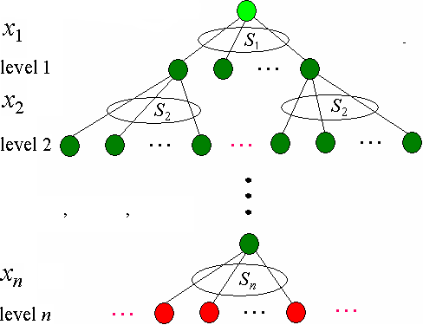
Subtree

Slide 12
Program Template for Subtree
Backtrack(i)
1 if i>n then Update(x)
2 else
3 for each a∈ S_{i} do
4 x_{i} ← a
5 if C(t) and B(i) then
6 Backtrack(i+1)

Slide 13
When the problem asks for an n-element permutation that optimizes some function, the solution space tree is a permutation tree.
Constructing all Permutations
How many permutations are there of an n-element set?
Set up an array of n elements, where the value of x_{i} is an integer from 1 to n which has not appeared thus far in the array, corresponding to the ith element of the permutation. There are n! permutations.
Permutation tree

Slide 14
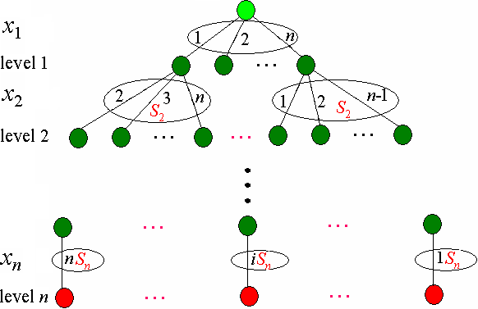
Permutation tree

Slide 15
Program Template for Subtree
Backtrack(i)
1 if i>n then Update(x)
2 else
3 for j←i to n do
4 x_{i} ↔x_{j}
5 if C(i) and B(i) then
6 Backtrack(i+1)
7 x_{i} ↔x_{j}

Slide 16
Make use of the bounding function and the constraint function to prune invalid branches and to focus the search on branches that appear most promising.
In order to improve the performance of search, applying backtracking requires specifying at least the following four points:
How to choose an the constraint function.
How to compute upper bounds (for maximum problem)
How to compute lower bounds (for minimum problem)
How to make use of the constraint function and the bounding function to prune.

Slide 17
Generally, for maximum problem, we compute the upper bound B(i) of the extend node i. If the current maximum objective value bestc is not less than B(i), then prune branch, otherwise, continue.
The objective value from root R to leaf L by i must be not bigger than B(i), so if B(i)≤bestc, then it show that searching the extend node i has no promising, so prune the extend node i. At the same time, the live node with maximum B(i) is priority to extend.
R
i
B(i)
L

Slide 18
Generally, for minimum problem, we compute the lower bound B(i) of the extend node i. If the current minimum objective value bestc is not bigger than B(i), then prune branch, otherwise, continue.
R
The objective value from root R to leaf L by i must be not less than B(i), so if B(i) ≥bestc, then it show that searching the extend node i has no promising, so prune the extend node i.
i
B(i)
L

Slide 19
2. Container Loading problem
Problem
Given n containers, container i has weight w_{i}. the ship can hold containers of total weight up to W.
Container Loading problem is to load as many containers as is possible without sinking the ship.
Solution space
Assuming that the solutions are represented by vectors (x₁,x₂,…,x_{n}), where x_{i}∈{0,1}, x_{i} =1 denotes container i are placed into the ship, x_{i} =0 denotes container i are not placed into the ship.

Slide 20
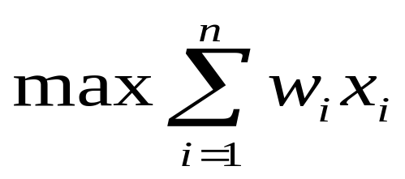
The container loading problem can be formally stated as follows:
The solution space tree
Subtree with 2^{n} leaves
At level j the members of the solution space are partitioned by their x_{j} values.

Slide 21
Subtree: n=4
x₁
1
0
0
1
0
x₂
1
x₃
x₄

Slide 22
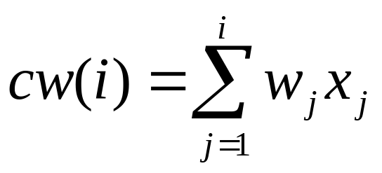
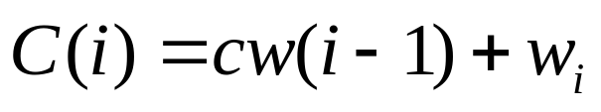

The constraint function
Let cw(i) denote the current weight up to level i, namely
then the constraint function is
Pruning
if then stop search level i and the following level, otherwise, continue to search.

Slide 23
Backtracking for n=4,w=[8,6,2,3], W=12
0
C(t)
Live nodes
x₁
1
Dead nodes
8
x₂
1
0
14
8
x₃
1
10
x₄
1
0
13
10
[1,0,1,0]

Slide 24
Recursive backtracking
BacktrackLoading(i)
1 if i>n then
2 if cw>bestw then
3 bestw ← cw
4 else
5 if C(i) ≤W then
6 cw ← cw+w[i]
7 BacktrackLoading(i+1)
8 cw ← cw-w[i]
9 BacktrackLoading(i+1)

Slide 25

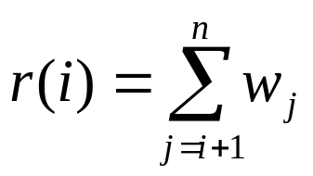

Improved backtracking
Make use of the bounding function
where, r(j) denotes the weight sum of the remaining containers, namely,
Pruning
if , then stop search level i and the following level, otherwise, continue to search. where, bestw denotes the best weight up to now

Slide 26
Backtracking n=4,w=[8,6,2,3], W=12
C(t)/B(t)
0/19
x₁
1
0
8/19
0/11
x₂
1
0
14/19
8/13
x₃
1
0
10/13
8/11
x₄
1
0
1
0
13/13
10/13
11/11
8/8
Bestw=10
Bestw=11

Slide 27
ImprovedBacktrackLoading(i)
1 if i>n then
2 if cw>bestw then bestw ← cw
3 else
4 r ← r-w[i]
5 if C(i)≤W then
6 cw ← cw+w[i]
7 ImprovedBacktrackLoading(i+1)
8 cw ← cw-w[i]
9 if B(i)>bestw then
10 ImprovedBacktrackLoading(i+1)
11 r ← r+w[i]

Slide 28
Constructing optimal solution
ImprovedBacktrackLoading1(i)
1 if i>n then
2 if cw>bestw then
3 bestw ← cw
4 for j ← 1 to n do
5 bestx[j] ← x[j]
6 else
7 r ← r-w[i]
8 if C(i) ≤W then x[i] ← 1
9 cw ← cw+w[i]
10 ImprovedBacktrackLoading1(i+1)
11 cw ← cw-w[i]
12 if B(i)>bestw then x[i] ← 0
13 ImprovedBacktrackLoading1(i+1)
14 r ← r+w[i]

Slide 29
3. 0/1 Knapsack problem
Problem
Given n objects, object i has weight w_{i} and value v_{i} the knapsack can hold containers of total capacity up to W.
0/1 Knapsack problem is to choose the subset of objects with maximum value of total capacity ≤W.
Solution space
Assuming that the solutions are represented by vectors (x₁,x₂,…,x_{n}), where x_{i}∈{0,1}, x_{i} =1 denotes object i are placed into the knapsack, x_{i} =0 denotes object i are not placed into the knapsack.

Slide 30
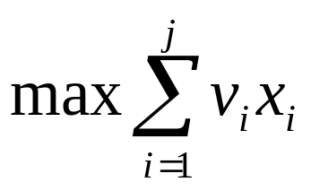
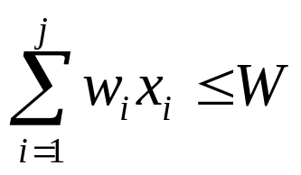
0/1 Knapsack problem can be formally stated as follows:
Such that
The solution space tree
Subtree with 2^{n} leaves
At level j the members of the solution space are partitioned by their x_{j} values.

Slide 31
Subtree: n=4
x₁
1
0
0
1
0
x₂
1
x₃
x₄

Slide 32
The constraint function
Let cw(i) denote the current weight up to level i, namely
then the constraint function is
Pruning
if then stop search level i and the following level, otherwise, continue to search.

Slide 33

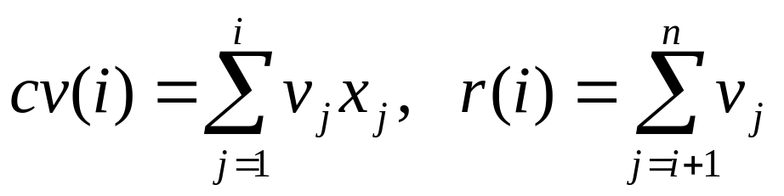

The bounding function
where, cv(i) denotes the current value up to level i, r(i) denotes the value sum of the remaining objects, namely,
Pruning
if , then stop search level i and the following level, otherwise, continue to search. where, bestv denotes the best value up to now

Slide 34
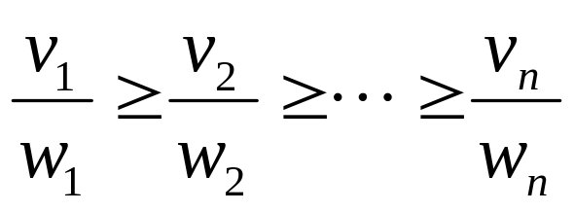
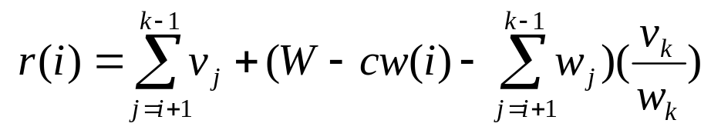
The bigger r(i) is, the more the branches of search is. Can we prune more branches? The answer is yes. In detail, we can construct the better bounding function as follows:
First, sort the objects in decreasing order of value/weight ahead of time, namely
Consider the level i, the remaining capacity of the knapsack is W-cw(i), place the remaining objects by greedy strategy into the knapsack until objects k cannot pace into it. SO

Slide 35
The computation of r(i) is more accurate, the value of r(i) is smaller than the original r(i), so it can prune more branches.
For example, given an instance: n=4, c=7, v=[9, 10, 7, 4], w=[3, 5, 2, 1], then v/w=[3, 2, 3.5, 4].
Sort the objects by v/w, then obtain a new instance:
n=4, c=7, v=[4, 7, 9, 10], w=[1, 2, 3, 5].
So v/w=[4, 3.5, 3, 2].

Slide 36
n=4, W=7, v=[4,7,9,10], w=[1,2,3,5] v/w=[4, 3.5, 3, 2].
C(t)/B(t)
0/22
C(t)/B(t)
C(t)/B(t)
x₁
0
1
C(t)/B(t)
1/22
0/20
0/20
x₂
1
0
1/19
3/22
1/19
x₃
1
0
6/22
3/19
3/19
x₄
0
6/20
20
[1,1,1,0]

Slide 37
BacktrackKnapsack(i)
1 if i>n then
2 if cv>bestv then
3 bestv ← cv
4 for j ← 1 to n do
5 bestx[j] ← x[j]
6 else
7 if C(i) ≤W then x[i] ← 1
8 cw ← cw+w[i]; cv ← cv+ v[i]
9 BacktrackKnapsack(i+1)
10 cw ← cw-w[i]; cv ← cv- v[i]
11 if B(i)>bestv then x[i] ← 0
12 BacktrackKnapsack(i+1)

Slide 38
r(i)
1 rw ← W- cw
2 b ← cv
3 while i +1≤ n and w[i+1] ≤ rw do
4 rw ← rw- w[i+1]
5 b ← b+ v[i+1]
6 i ← i+1
7 if i +1≤ n then b ← b+ v[i+1]/w[i+1] × rw
8 return b

Slide 39

5. n queen problem
Problem
Given n queens and a chessboard, the n queen problem is to place n queens on a chessboard such that no queens are attacking another queen.
For example, n=4

Slide 40
Solution space
Let x_{i} denotes the column position of the ith queen, then the solution space of the problem is (x₁,x₂,…,x_{n}), since no two queens can be put in the same row, so the size of solution space is n^{n}. The solution space can be organized as a subtree. If each queen is restricted within different row, the size of solution space can be reduced form n^{n} to n!, The solution space can be organized as a permutation tree

Slide 41
The constraint function
Two queens are not allowed in the same row, or in the same column, or along the same diagonal.
two queens places at positions x_{k} and x_{j} are in the same column if and only if x_{k}=x_{j}
two queens are in the same diagonal if and only if
x_{k}-x_{j}=k-j or x_{k}-x_{j}=j-k
Namely
|x_{k}-x_{j}|=|k-j|

Slide 42
Subtree: n=4
x₁
1
2
3
4
x₂
1
2
3
4
1
2
3
4
x₃
1
2
3
4
1
2
3
4
x₄
1
2
3
4
success

Slide 43
BacktrackNqueens()
1 x[1] ← 0
2 k ← 1
3 while k>0 do
4 while x[k] ≤n-1 do
5 x[k] ← x[k] +1
6 if place(k)=True then
7 if k=n then SolNum ← SolNum +1
8 else
9 k ← k+1
10 x[k] ← 0
11 k ← k-1

Slide 44
Place(k)
1 for j←1 to k-1 do
2 if |k-j|=|x[k]-x[j]| or x[j]=x[k] then
3 return False
4 return True

Slide 45
6. Traveling Salesperson Problem
Problem
Given an n vertex network (either directed or undirected) and are to find a cycle of minimum cost that includes all n vertices. Any cycle that includes all n vertices of a network is called a tour. In the traveling-salesperson problem, we are to find a least-cost tour.
Some of the tours in this network are 1,2,4,3,1; 1,3,2,4,1; and 1,4,3,2,1.
The cost of the tour 1,3,2,4,1 is 25, it is the least-cost tour in the network.
1
30
2
5
6
10
4
3
4
20

Slide 46
Solution space
Since a tour is a cycle that includes all vertices, we may pick any vertex as the start (and hence the end). Let us arbitrarily select vertex 1 as the start and end vertex. Each tour is then described by the vertex sequence 1, x₂,…,x_{n}, 1 when x₂,…,x_{n} is a permutation of (2, 3, …, n). The possible tours may be described by a permutation tree in which each root-to-leaf path defines a tour.
The size of the solution space is 3!

Slide 47
Permutation tree: n=4
x₁
1
x₂
2
3
4
x₃
3
4
2
4
2
3
x₄
2
3
2
4
3
4

Slide 48
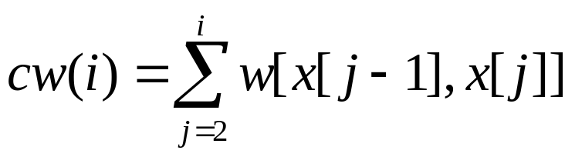
Data structure
Let w[i, j] denotes the weight or cost of vertex i and vertex j, if w[i, j]= ∞ denotes no edge between vertex i and vertex j and x[i] denotes the vertex to be searched.
The constraint condition
w[x[i],x[j]]= ∞, prune branch
The bounding function
B(i)=cw(i-1)+w[x[i-1],x[i]], where,
Pruning
if B(i)>bestw, then stop search level i and the following level, otherwise, continue to search. where, bestw denotes the minimum cost up to now

Slide 49
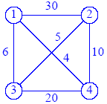
For example
B(i)
0
x₁
1
0
x₂
2
3
4
30
6
4
3
x₃
4
2
35
40
11
26
14
24
x₄
3
4
3
55
60
21
19
29
59
25
25
59

Slide 50
BacktrackTSP(i)
1 if i = n then
2 if w[x[n-1],x[n]]≠∞ and w[x[n],1]≠∞ then
3 if cw + w[x[n-1],x[n]]+ w[x[n],1] < bestw then
4 bestw←cw+w[x[n-1],x[n]]+ a[x[n],1]
5 for j ← 1 to n do
6 bestx[j] ← x[j]
7 else for j ← i to n-1 do
8 if w[x[i-1],x[j]]≠∞ and cw+ w[x[i-1], x[j]] < bestw then
9 x[i] ↔x[j]
10 cw ←cw+ w[x[i-1],x[i]]
11 BacktrackTSP(i +1)
12 cw ←cw-w[x[i-1], x[i]]
13 x[i] ↔x[j]

Slide 51
Other Applications:The game problem
Given a maze, find a path from start to finish
At each intersection, you have to decide between three or fewer choices:
  Go straight
  Go left
  Go right
You don’t have enough information to choose correctly
Each choice leads to another set of choices
One or more sequences of choices may (or may not) lead to a solution
Many types of maze problem can be solved with backtracking

Slide 52
Homework
Page 238-240
  1.Reading 12.4 and 12.7
  2.12.1 12.10 12.17
  12.18 and 12.19每个至少两题

Slide 53
实验课程设计

Slide 54
回溯算法的应用
零件切割问题
给定一块宽度为W的矩形板，矩形板的高度不受限制。现需要从板上分别切割出n个高度为h_{i}，宽度为w_{i}的矩形零件。切割的规则是零件的高度方向与矩形板的高度方向保持一致。问如何切割使得所使用的矩形板的高度h最小？
例如：
h₁=3
w₁=2
h₂=2
w₂=4
h₃=1
w₃=5
h=4
W=8

Slide 55
要求
请设计出一个回溯算法
程序设计
  任给一个输入实例，能输出切割所需要的实际高度
  能用图形演示切割的过程

